Slide 1
Lesson objective
Title: Decimal operations
Aim:
Use the four operations to solve problems involving decimals
Plan:
Review rounding and converting
Conduct 4 operations

Slide 2
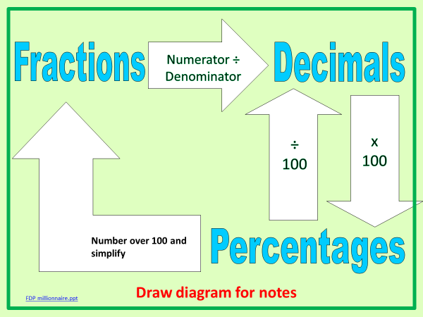

Converting FDP re-teach
Fraction Decimal Percent
$$\frac{2}{10}$$
______
______
______
0.45
______
______
______
70%

Slide 3



Converting
No calculators, convert the following in your exercise book:
Fraction Decimal Percent
$$\frac{6}{10}$$
______
______
______
$$0.4$$
______
______
______
$$35\%$$

Slide 4
Rounding
5 or more ➔ raise the score
4 or less ➔ let it rest

Slide 5
Rounding Decimals
Chop it and check it
    Chop off the number after the d.p. you want
    Check the next digit and change if it’s 5 or more
Rounding to 1 d.p
4 . 8 3 2 5
4. 8 4 2 5
4. 8 5 2 5
5 or more ?
5 or more ?
5 or more ?
No
No
Yes
4.8
4.8
4.9

Slide 6
Rounding to 2 d.p
Chop it and check it
5. 8 4 2 5
1. 4 2 6 1
0. 6 0 8 3
5 or more?
5 or more?
5 or more?
No
Yes
Yes
5.84
1.43
0.61
0. 2 9 4 3
0. 5 5 5 0
0. 3 9 7 0
5 or more?
5 or more?
5 or more?
No
Yes
Yes
0.29
0.56
0.40

Slide 7
Rounding to 3 d.p
Chop it and check it
5. 8 4 2 5 4
1. 4 2 6 1 8
0. 6 0 8 3 4
5 or more?
5 or more?
5 or more?
Yes
No
No
5.843
1.426
0.608
6. 2 9 4 7 1
5. 4 0 0 9 7
0. 3 9 9 7 7
5 or more?
5 or more?
5 or more?
Yes
Yes
Yes
6.295
5.401
0.400

Slide 8
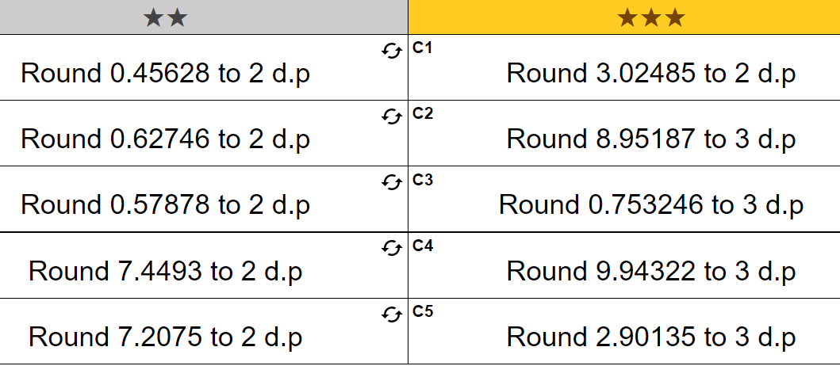
Exercise books

Slide 9
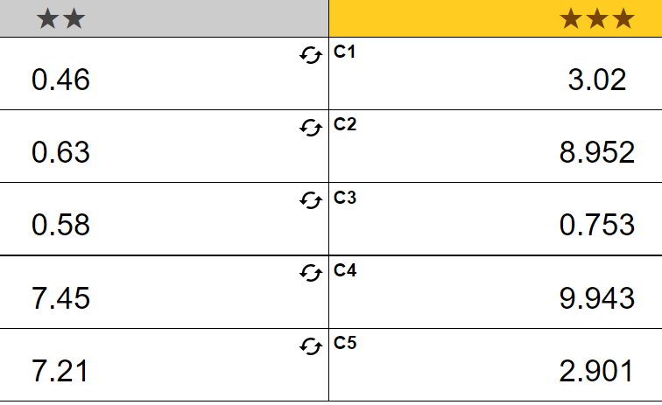
Answers

Slide 10
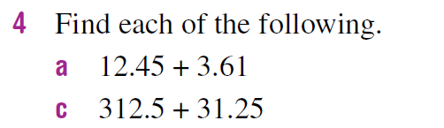
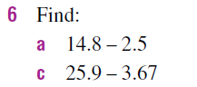
Adding and Subtracting Decimals
Line up the decimal point (NOT the right hand side!)
Put a zero in all blank decimal places when subtracting
12.45
312.5
14.8
25.9
0
3.61 +
31.25 +
2.5 -
3.67 -
.
.
.
.

Slide 11
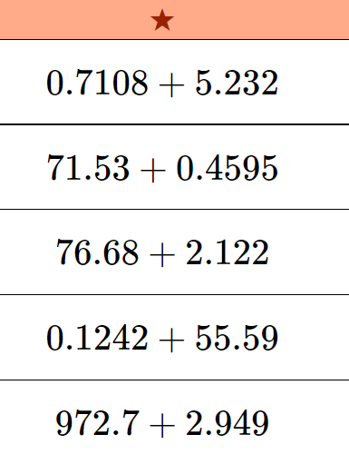
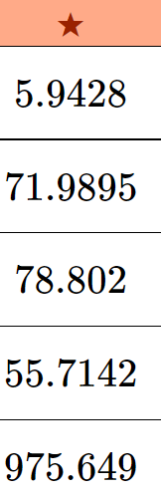
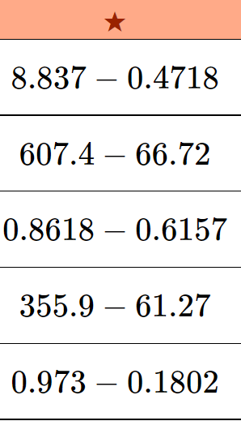
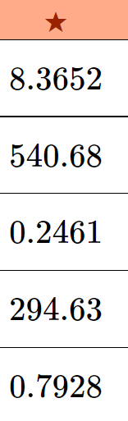
Exercise books

Slide 12
Multiply Decimals – Lattice Method
Draw the grid
Multiply the numbers
Add up the diagonals
Count the decimal places in the question and ensure the same number of places is in the answer
.
8.71 x 11.2
= 9 7 5 5 2
Page 318 Ex 6E
Q 6
Q 6jkl
9-12
Q
9-17

Slide 13
Divide Decimals
Find out ‘how many’ are in each digit
Carry any remainder to the next digit
If there is a remainder, write a zero and carry the remainder to this digit
79 ÷ 4
= 19.75
3.027 ÷ 6
= 0.5045
Page 323 Ex 6F
Q 5
Q 5
Q 5

Slide 14
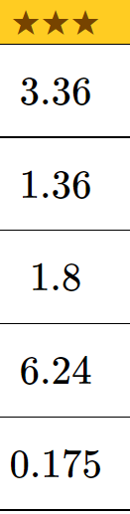
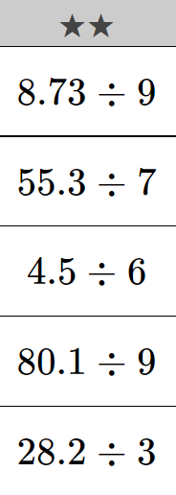
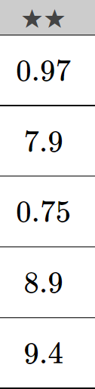
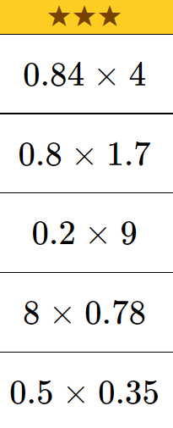
Exercise books

